Slide 1

Project 1: Life Expectancy (WHO)
Sadaf Shahbaz
Agnesa Percuku Gerxhaliu

Slide 2
1. Introduction to Data Set
2. Exploratory Data analysis 2.1.Has life expectancy improved over the years ? 2.2.Does population have an impact on long life? 2.3.Are Wealthy countries being more likely to live longer? 2.4. Should countries with lower life expectancy increase their percentage expenditure on Health? 2.5.What is main reason of very low LE in Africa? 2.6. Do education helps make people improving LE?
3. Predicting life expectancy
4.Logistic Regression to predict status
5. Conclusions and Recommendations

Slide 3
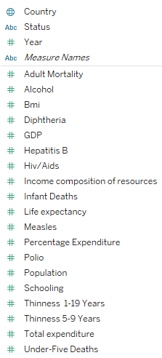
Life Expectancy dataset

Slide 4
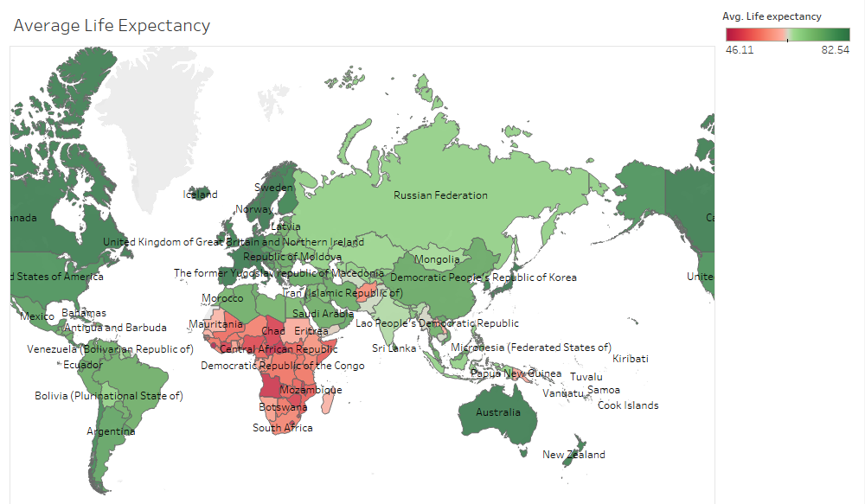

Slide 5
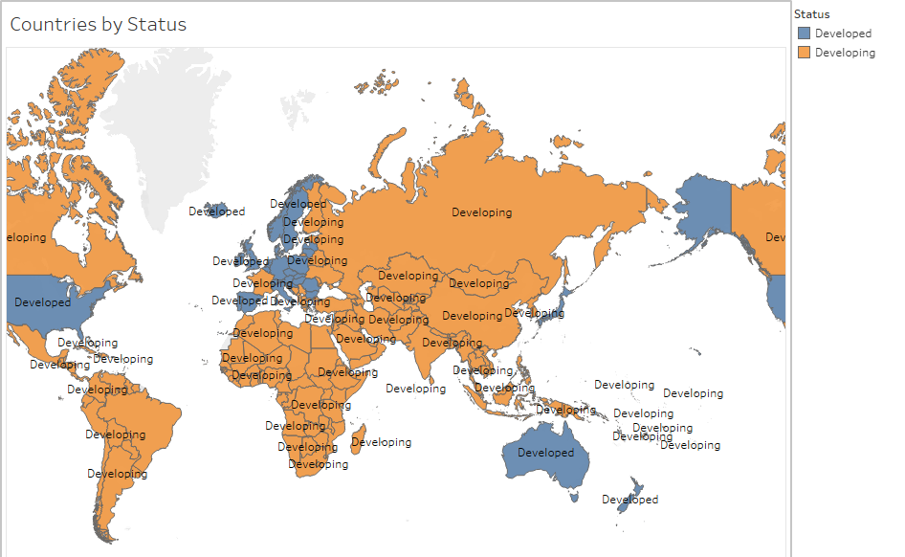

Slide 6
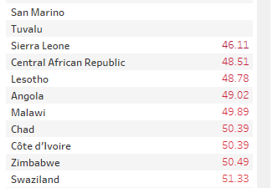
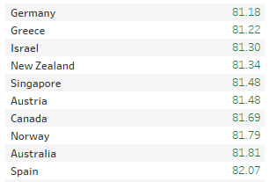
Countrie with lowest and highest life avg. life expectancies

Slide 7
Data Preprocessing
Standardize columns: lowercase, remove spaces
Remove duplicates
Removing Null– using KNN imputer
Handle outliers using quartiles
Transform categorical values using dummification

Slide 8
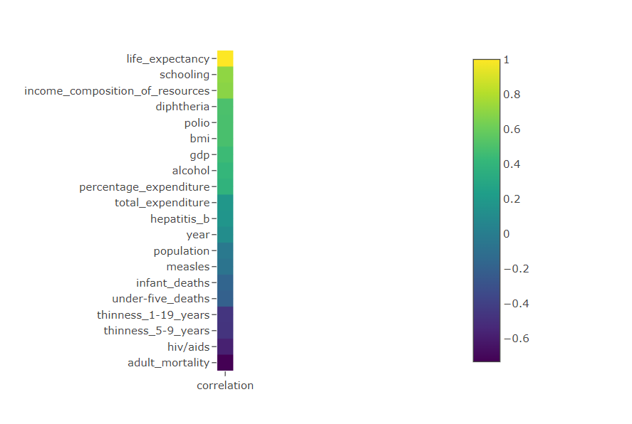
Correlation Coefficient
Except Diphtheria, polio, alcohol and hepatitis B are coefficients are explainable.

Slide 9
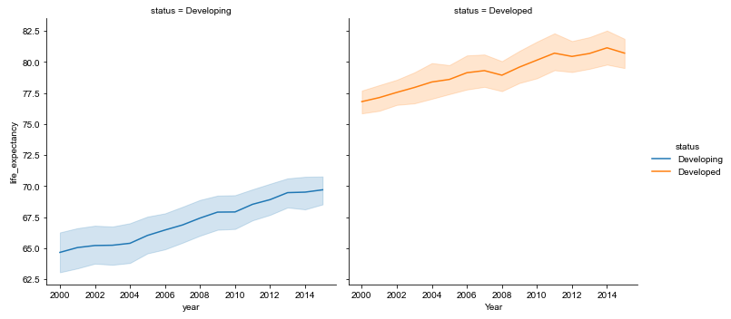
Has life expectancy improved over the years ?

Slide 10
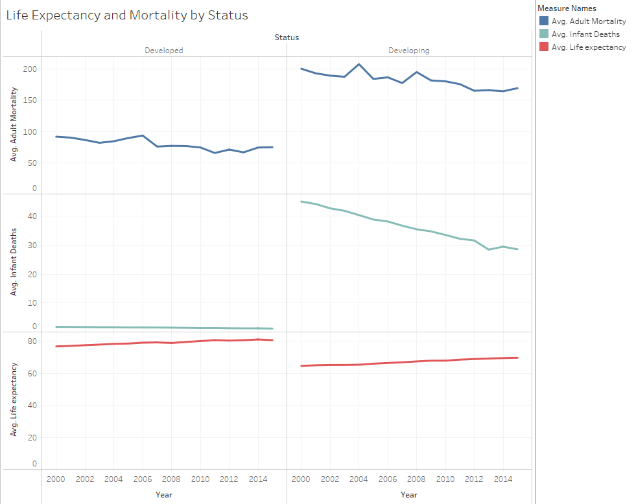
Developing countries-higher adult and infant deaths and lower life expectancy compared to developed countries.
But we see that with time, the deaths are going down and life expectancy slowly going up.

Slide 11
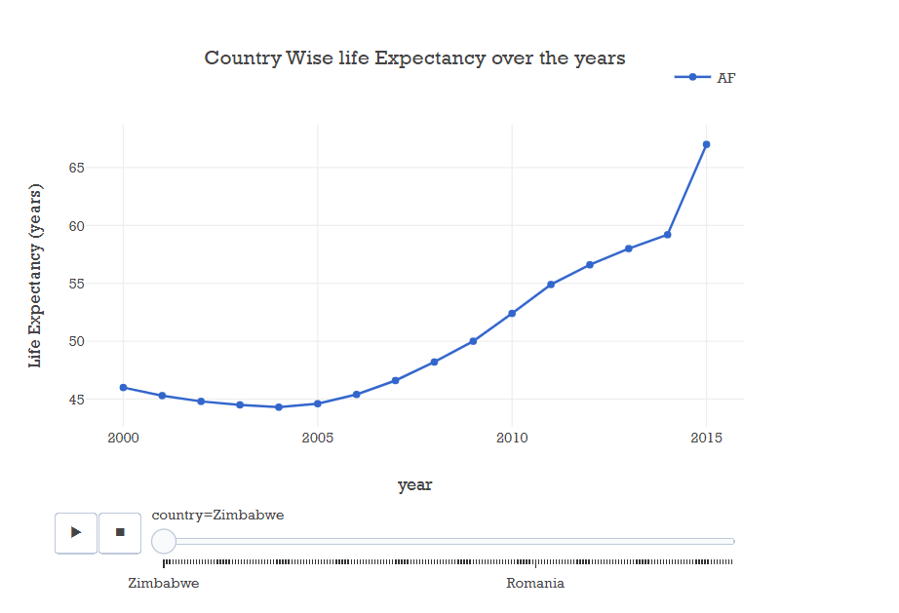

Slide 12
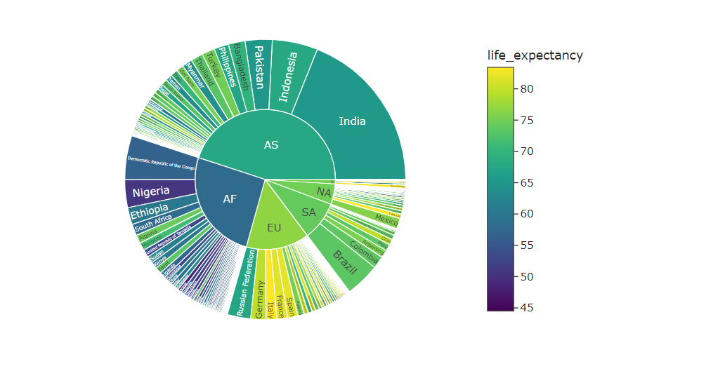
Does population have an impact on long life?

Slide 13
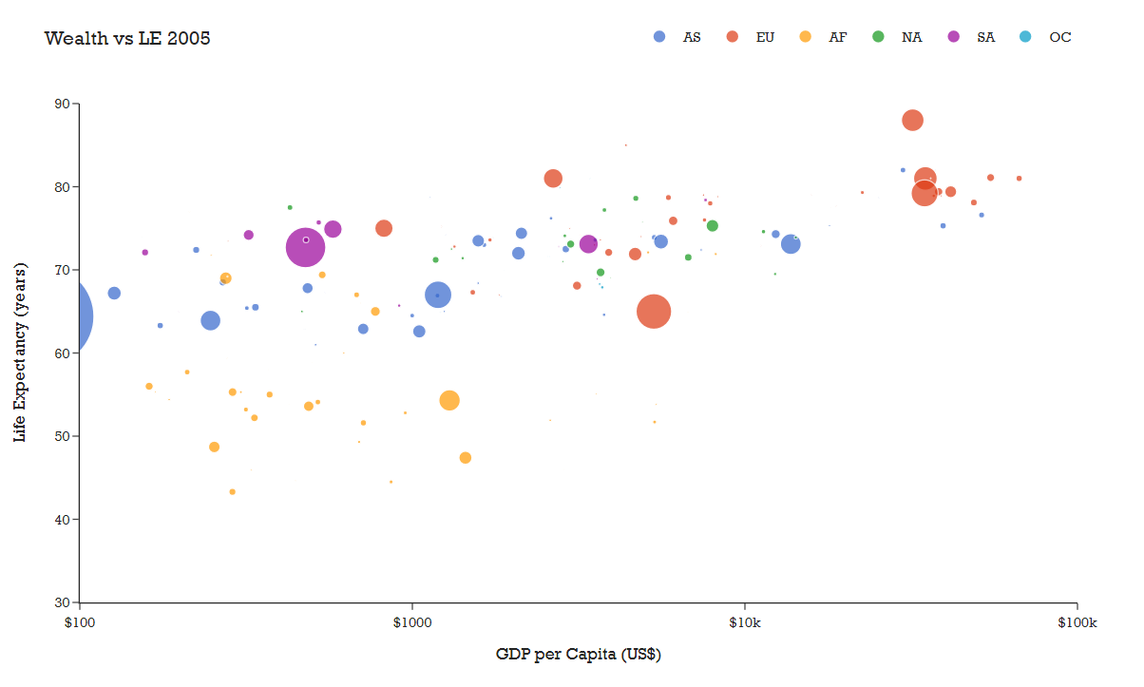
Are Wealthy countries being more likely to live longer?

Slide 14
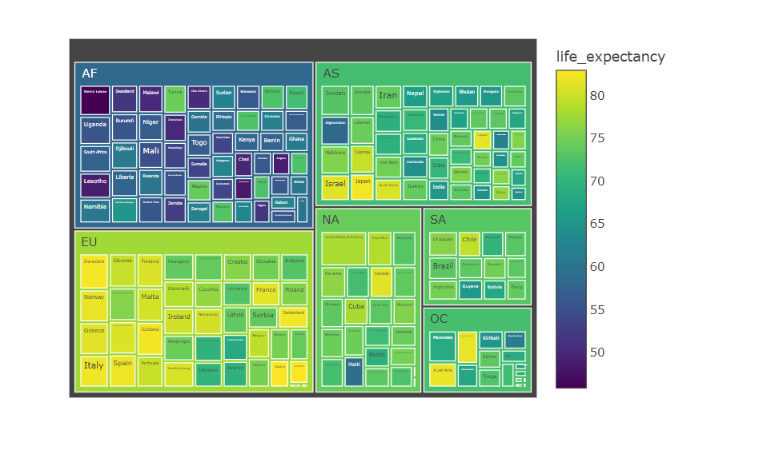
Should countries with lower life expectancy increase their percentage expenditure on Health?

Slide 15
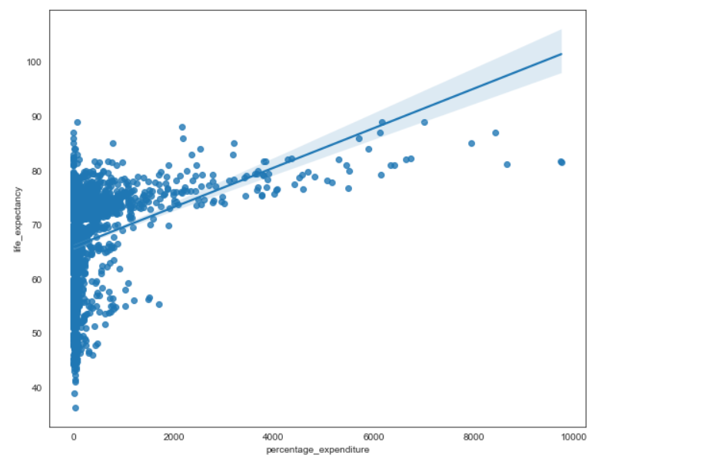
Regression plot (developing countries)
Narrow confidence interval
Most of obs. are around fitted line.

Slide 16
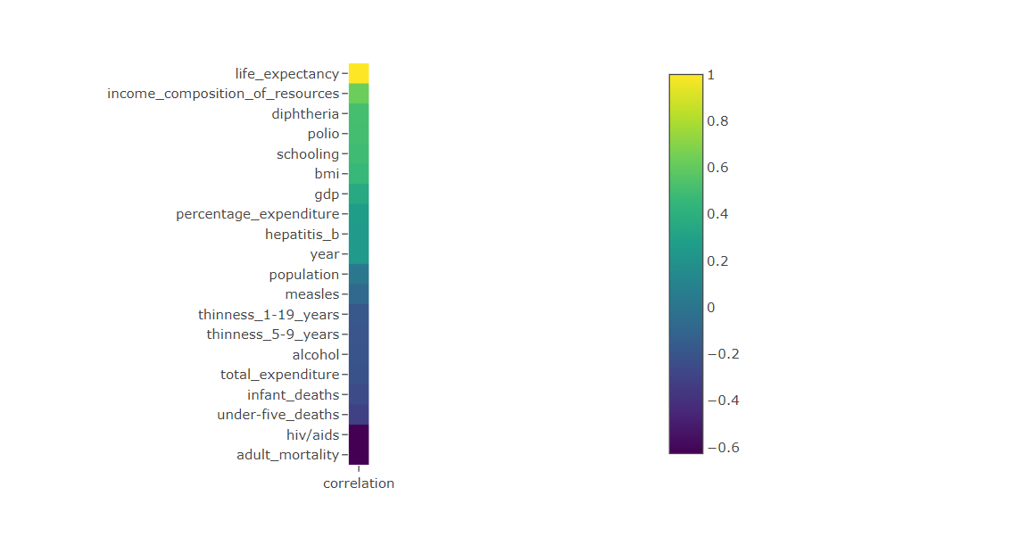
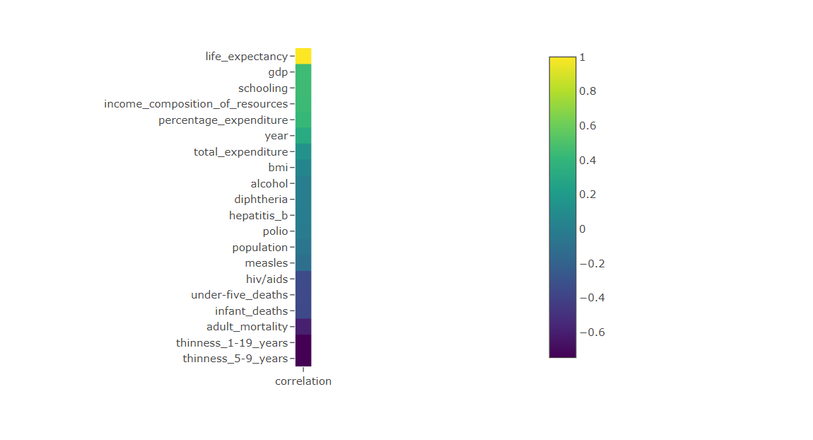
What is main reason of very low LE in Africa?
Correlation coefficients (Africa)
Correlation Coefficients (Europe)

Slide 17
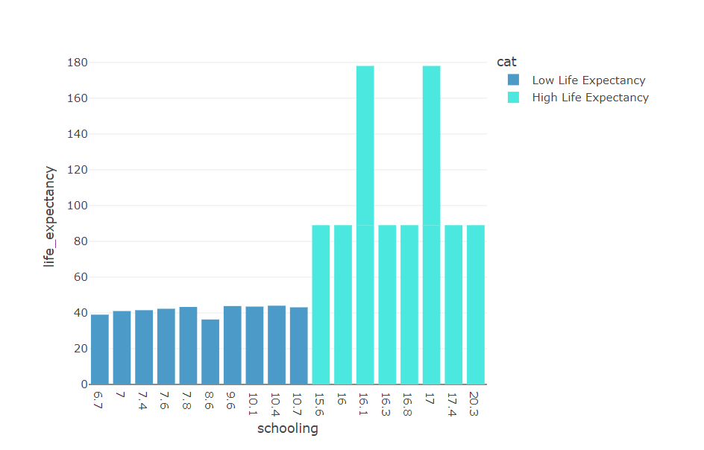
Do education helps make people improving LE?

Slide 18
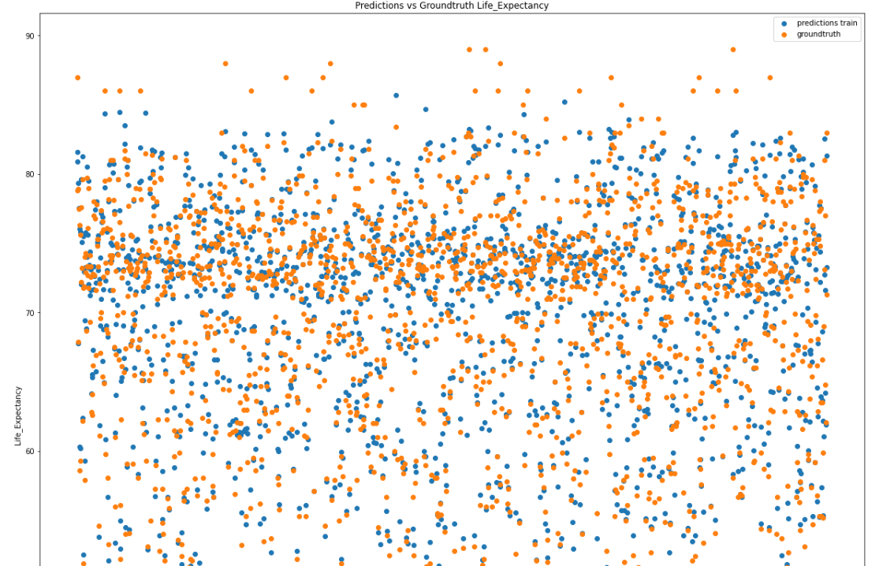
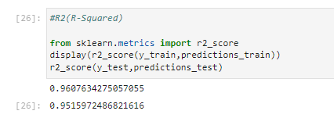
Linear Regression
The linear regression model seems to be
a good model for predicting Life Expectancy.
R2 score in training is 0.96 while in testing 0.95

Slide 19
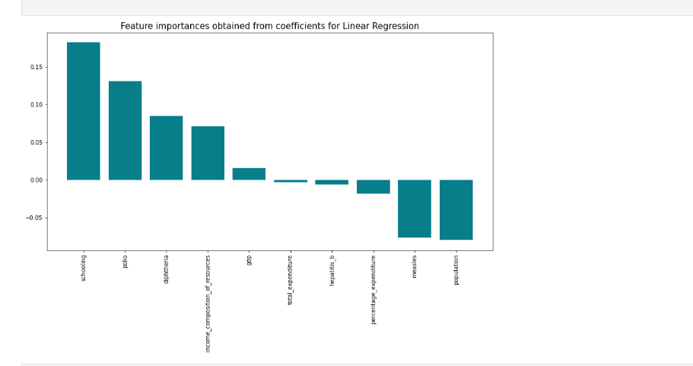
Feature Importance

Slide 20
Logistic Regression
Target Variable = Status (Developed = 0, Developing = 1)
Explanatory variables = life_expectancy adult_mortality, infant_deaths, alcohol, percentage_expenditure, hepatitis_b, diphtheria, hiv/aids, gdp,population, thinness-1-9 years, thinness 5-9 years, income composition of resources, schooling, measles, under_five_deaths, polio, total_expenditure

Slide 21
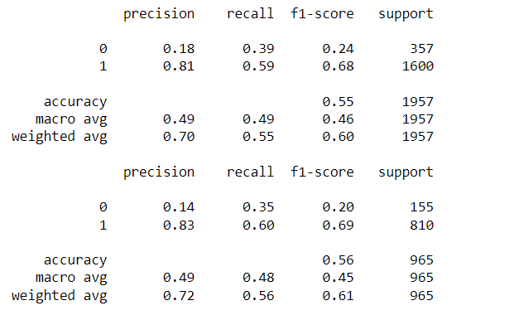
Classification Report
accuracy on train set: 0.5528870720490546
accuracy on test set: 0.5575129533678757
Precision – What percent of your predictions were correct?
Precision = TP/(TP + FP)
Recall – What percent of the positive cases did you catch?
Recall = TP/(TP+FN)
F1 score – What percent of positive predictions were correct?

Slide 22
Problem in Model
Need to balance data
Resampling the data
1.Downsampling
2. Upsampling
Imbalanced Data
No. of observation for developed class = 512
No. of observations for developing class = 2410

Slide 23
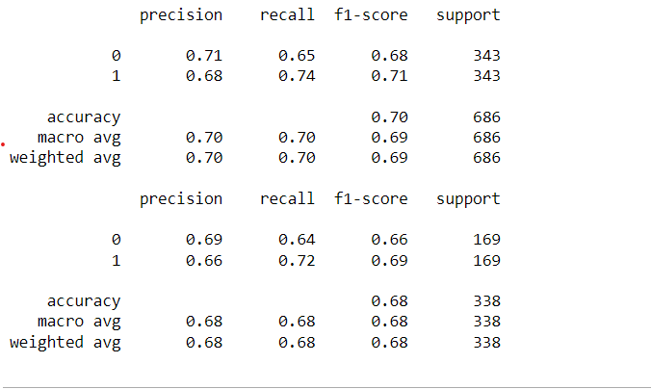
Classification Report after Down sampling 0= developed = 512 1= developing = 512

Slide 24
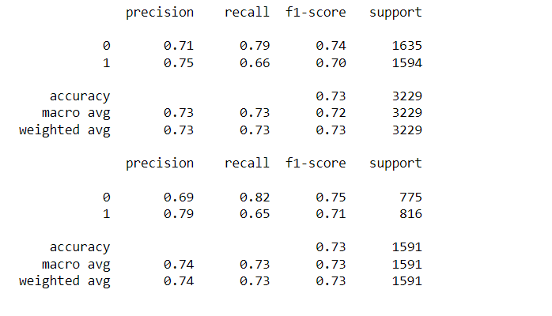
Classification Report after Up sampling developed = 2410 developing = 2410

Slide 25
Feature Importance
1. Alcohol
2. Life expectancy
3. Income composition of resources
4. Thinness 1-9 years
5 Adult Mortality
6. gdp
7.bmi
8. percentage expenditures
9. polio
10. total expenditures
11. diphtheria
12. HIV/Aids
13. Hepatitis b
14. under five deaths
15. infant deaths
16. Measles
17. population

Slide 26

Conclusion
EDA shows:
LE is getting better over the years in both developing and developed countries.
In order to improve LE govts needs to spend more money to increase percentage expenditures on health, education and controlling diseases.
Analysis also reveals some abnormal positive relationships e.g. +ive relationship of alcohol, dipherthia, etc. needs further investigation.
Even with abnormalities in dataset model predicted very well life expectancy. Needs further investigation , what are the most important features.
Model with oversampling technique performed best. Next step could be to select features by using ANOVA and rerun the model.

